Slide 1

PYTHON APPLICATION PROGRAMMING
Team Python
Department of Computer Science
and Engineering

Slide 2

PYTHON FOR COMPUTATIONAL PROBLEM SOLVING
Encapsulation And Inheritance
Chitra G M
Department of Computer Science and Engineering

Slide 3
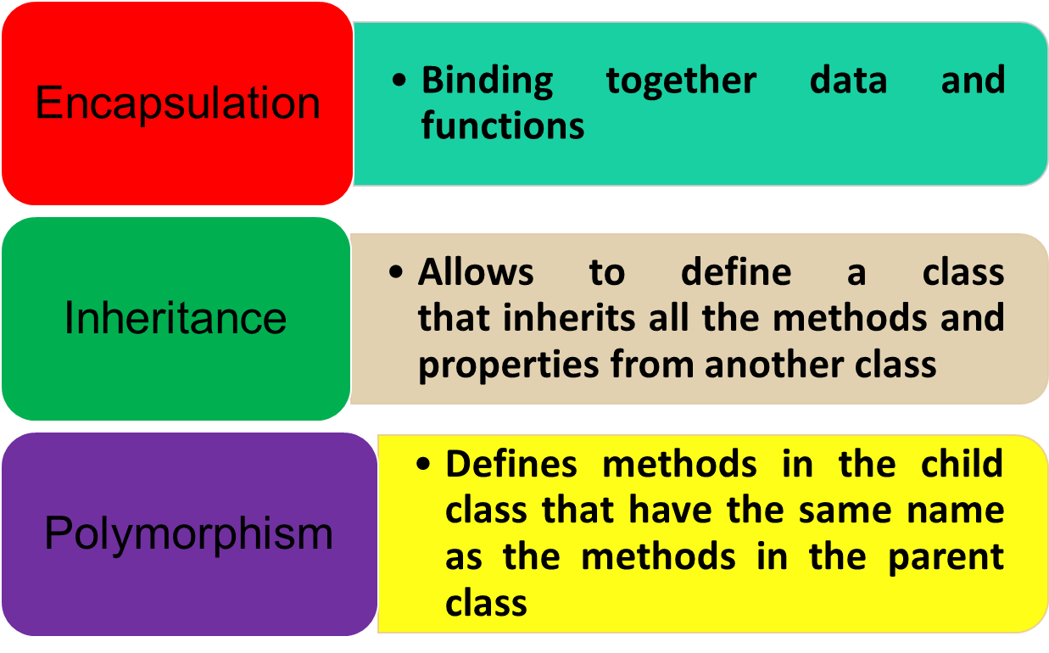
PYTHON FOR COMPUTATIONAL PROBLEM SOLVING
Introduction
Fundamental Concepts Of OOP in Python

Slide 4
PYTHON FOR COMPUTATIONAL PROBLEM SOLVING
Encapsulation(1)
Encapsulation is used to restrict access to methods and variables
In encapsulation, code and data are wrapped together within a single unit
It prevents data from direct modification
Access modifiers are used to control access to class resources.
For Example:public,private
All members in a Python class are public by default.
Any member can be accessed from outside the class environment.

Slide 5
PYTHON FOR COMPUTATIONAL PROBLEM SOLVING
Encapsulation(1)
The object of the same class is required to invoke a public method.
Private members of a class are denied access from the environment outside the class.
They can be handled only from within the class

Slide 6
PYTHON FOR COMPUTATIONAL PROBLEM SOLVING
Encapsulation(3)
class Person:
def __init__(self,name,age):
self.name = name
self.age = age
p = Person("shaun",14)
print(p.name)
Output:
shaun
Add
Output:
Vinay
p.name = "Vinay"
print(p.name)

Slide 7
private attribute
A double underscore __ is prefixed to a variable to make it private. It gives a strong suggestion not to touch it from outside the class. Any attempt to do so will result in an AttributeError:
PYTHON FOR COMPUTATIONAL PROBLEM SOLVING
Encapsulation(3)
private attribute
A double underscore __ is prefixed to a variable to make it private
It gives a strong suggestion not to touch it from outside the class.
Any attempt to do so will result in an AttributeError
class A:
def __init__(self,name,age):
self.__name = name # private attribute
self.__age = age # private attribute
x = A("Shaun",14)
print(x.__name)
Output:
AttributeError: 'A' object has no attribute '__name'

Slide 8
private attribute
A double underscore __ is prefixed to a variable to make it private. It gives a strong suggestion not to touch it from outside the class. Any attempt to do so will result in an AttributeError:
PYTHON FOR COMPUTATIONAL PROBLEM SOLVING
Encapsulation(3)
Getter and Setter methods
getters are the methods which help access the private attributes or get the value of the private attributes
setters are the methods which help change or set the value of private attributes

Slide 9
private attribute
A double underscore __ is prefixed to a variable to make it private. It gives a strong suggestion not to touch it from outside the class. Any attempt to do so will result in an AttributeError:
PYTHON FOR COMPUTATIONAL PROBLEM SOLVING
Encapsulation(3)
class A:
def __init__(self,name = "Shaun"):
self.__name = name
# make getter method
def getname(self):
return self.__name
# make setter method
def setname(self,name):
self.__name = name
x = A()
print(x.getname())
x.setname("joe")
print(x.getname())
Output:
Shaun
joe

Slide 10
private attribute
A double underscore __ is prefixed to a variable to make it private. It gives a strong suggestion not to touch it from outside the class. Any attempt to do so will result in an AttributeError:
PYTHON FOR COMPUTATIONAL PROBLEM SOLVING
Inheritance(1)
Powerful feature in object oriented programming
Defines a class that inherits all the methods and properties from another class.
The new class is called derived (or child) class
The one from which it inherits is called the base (or parent) class.
Derived class inherits features from the base class, adding new features to it.
Provides re-usability of code
Inheritance establishes “is a” relationship between classes

Slide 11
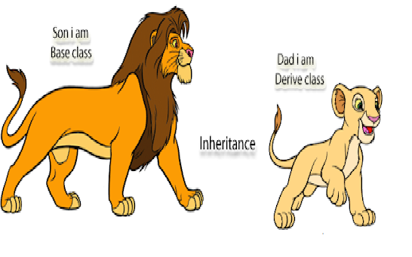
private attribute
A double underscore __ is prefixed to a variable to make it private. It gives a strong suggestion not to touch it from outside the class. Any attempt to do so will result in an AttributeError:
PYTHON FOR COMPUTATIONAL PROBLEM SOLVING
Inheritance(2)
Syntax:
class Baseclass(Object):
body_of_base_class class
DerivedClass(BaseClass):
body_of_derived_class

Slide 12
private attribute
A double underscore __ is prefixed to a variable to make it private. It gives a strong suggestion not to touch it from outside the class. Any attempt to do so will result in an AttributeError:
PYTHON FOR COMPUTATIONAL PROBLEM SOLVING
Inheritance(3)
class A:
pass
class B(A):
pass
issubclass(B,A)
Output:
True
The function returns True if B is a subclass of A,and False otherwise

Slide 13
private attribute
A double underscore __ is prefixed to a variable to make it private. It gives a strong suggestion not to touch it from outside the class. Any attempt to do so will result in an AttributeError:
PYTHON FOR COMPUTATIONAL PROBLEM SOLVING
Inheritance(4)
class Animal:
def speak(self):
print("Animal Speaking")
#child class Dog inherits the base class Animal
class Dog(Animal):
def bark(self):
print("dog barking")
d = Dog()
d.bark()
d.speak()
Output
dog barking
Animal Speaking

Slide 14
private attribute
A double underscore __ is prefixed to a variable to make it private. It gives a strong suggestion not to touch it from outside the class. Any attempt to do so will result in an AttributeError:
PYTHON FOR COMPUTATIONAL PROBLEM SOLVING
Inheritance(5)
class Base:
def __init__(self,subject):
self.subject= subject
def __str__(self):
return "The subject name is " + self.subject + "."
class Derived(Base):
def __init__(self, name):
Base.__init__(self, name)
obj = Derived("Python")
print(obj)
Output:
The subject name is Python

Slide 15
private attribute
A double underscore __ is prefixed to a variable to make it private. It gives a strong suggestion not to touch it from outside the class. Any attempt to do so will result in an AttributeError:
PYTHON FOR COMPUTATIONAL PROBLEM SOLVING
Inheritance(5)
When we create an object of the derived class, we invoke the constructor of the derived class which in turn calls the base class constructor on the base class sub object.
The base class provides a default implementation of the behaviour for the derived class.
The class defines the __str__() method, too, which makes the class able to present its identity in clear text form.

Slide 16
private attribute
A double underscore __ is prefixed to a variable to make it private. It gives a strong suggestion not to touch it from outside the class. Any attempt to do so will result in an AttributeError:
PYTHON FOR COMPUTATIONAL PROBLEM SOLVING
Inheritance(6)-Instance Variables
class A1:
def __init__(self):
self.abc = 111
class B1(A1):
def __init__(self):
super().__init__()
self.pqr = 222
obj = B1()
print(obj.abc)
print(obj.pqr)
Output:
111
222

Slide 17
private attribute
A double underscore __ is prefixed to a variable to make it private. It gives a strong suggestion not to touch it from outside the class. Any attempt to do so will result in an AttributeError:
PYTHON FOR COMPUTATIONAL PROBLEM SOLVING
Inheritance(6)-Order to access an object’s entity
Inside the object itself
In all classes involved in the object's inheritance line from bottom to top
If there is more than one class on a particular inheritance path, Python scans them from left to right.
If it fails to find it in both the above mentioned things, an exception called as AttributeError is raised

Slide 18
private attribute
A double underscore __ is prefixed to a variable to make it private. It gives a strong suggestion not to touch it from outside the class. Any attempt to do so will result in an AttributeError:
PYTHON FOR COMPUTATIONAL PROBLEM SOLVING
Overriding
To override a method in the base class, we must define a new method with same name and same parameters in the derived class
Example:
class A: #parent class
def display(self):
print ('This is base class.')
class B(A): #derived class
def display(self):
print ('This is derived class.')
obj = B()
obj.display()
Output:
This is derived class.

Slide 19
private attribute
A double underscore __ is prefixed to a variable to make it private. It gives a strong suggestion not to touch it from outside the class. Any attempt to do so will result in an AttributeError:
The isinstance() function returns True if the specified object is of the specified type, otherwise False.
PYTHON FOR COMPUTATIONAL PROBLEM SOLVING
isinstance()
The isinstance() function returns True if the specified object is of the specified type, otherwise False
class myObj:
name = "John"
y = myObj()
x = isinstance(y, myObj)
print(x)
Output:
True

Slide 20
THANK YOU
Team Python*
Department of Computer Science and Engineering
Contact Email ID’s:
chitragm@pes.edu

